Slide 1


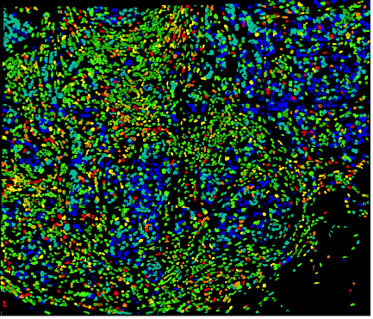
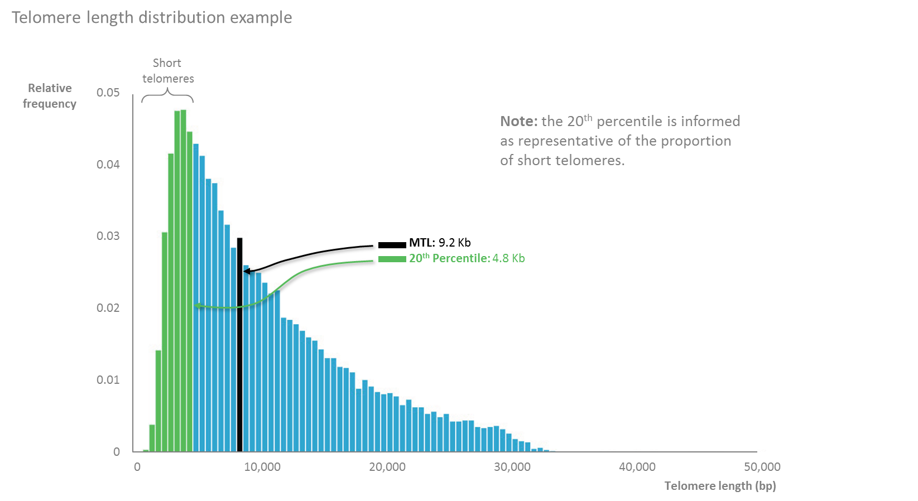
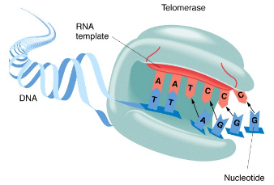
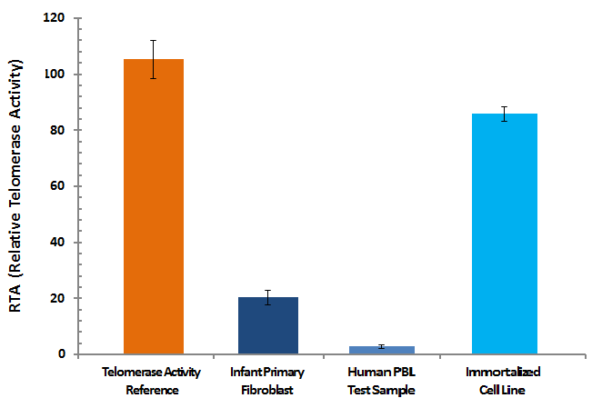
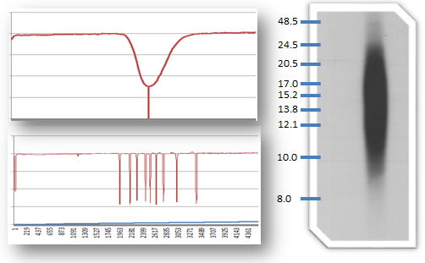
FOUR , complementary, Telomere Analyses Technologies
TELOMAPPING® patented methodology telomere length is determined in tissue samples
(biopsies)
TAT® proprietary for the quantification of telomere length individually
(in blood samples and from cell culture)
TRF
Terminal Repeat Fragment Assay
A complementary assay for telomere length determination (when only DNA is available)
TRAP
Telomeric Repeat Amplification Protocol
A highly sensitive measurement of telomerase activity
(in blood samples and from cell culture)

